Slide 1










Healthcare analytics report
Presented by Dr Doaa Hussein

Slide 2



Our case study
We have a medical health care system and we want to investigate
To what extent the medical condition affected by age and gender
To what extent the medication regimen affected by age and gender
How the insurance amount affected by the hospitals and the addition type
How the insurance amount affected by the insurance providers
What is the average billing amount by year

Slide 3


Distribution of medical condition by age and gender

Slide 4

Medication regimen by age and gender

Slide 5


Effect of hospital and admission type on the insurance

Slide 6


Effect of insurance providers on billing amount

Slide 7
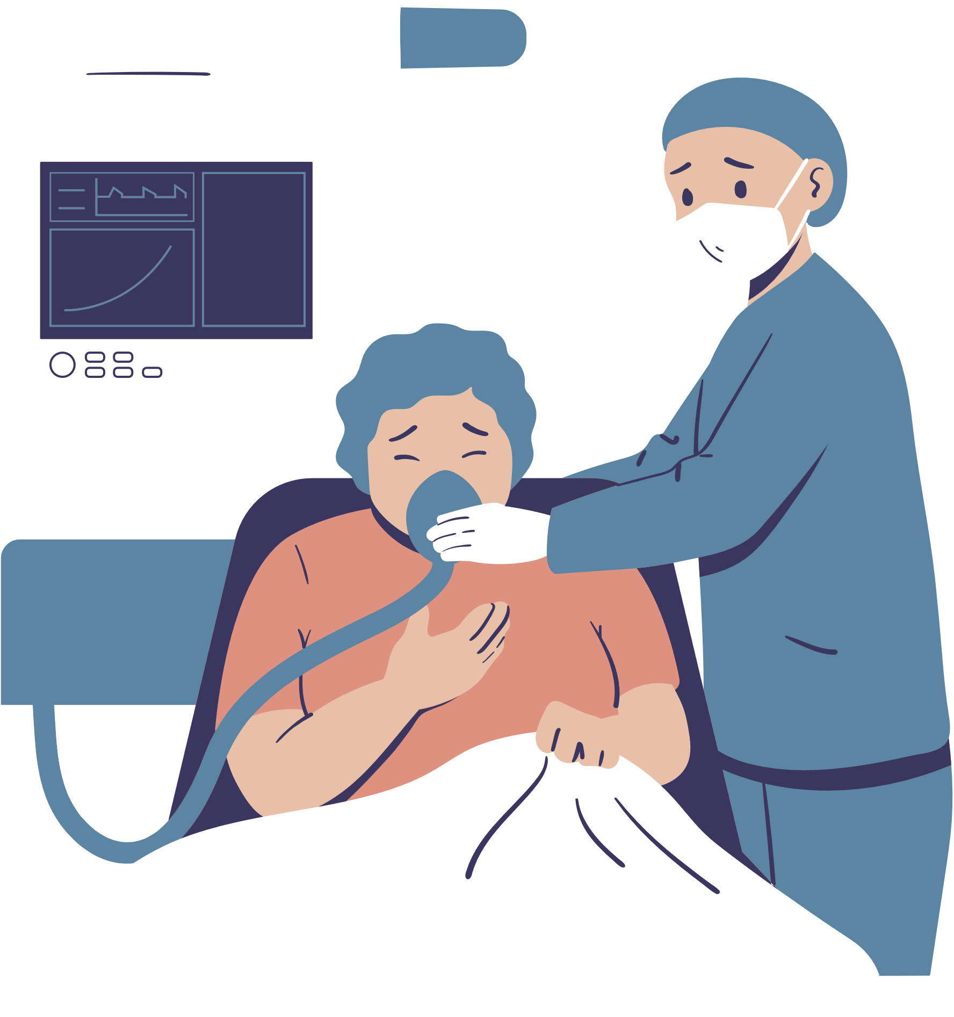

Average of billing amount by year

Slide 8


Conclusion
The highest average billing amount was found in 2018 (27.700)
The highest billing amount was provided from Aetna provider (302.57 M)
The Emergency admission type is the highest department that receive the insurance specially in Inc Jones hospital
Diabetes is the highest disease that affected by both age and gender specially in female at age of 50 year
Female receive more medication than males at all ages specially aspirin medicine

Slide 9


Slide 10
Thank you for your attention

